Slide 1
Refining the concept of ESUS – A longitudinal 5–year follow-up study
Emanuel Martins, Pedro Faustino, Fábio Gomes, Carolina Fernandes, Bruno Rodrigues, Cristina Machado, Gustavo Santo, Luciano Almendra, João Sargento-Freitas, Fernando Silva
Neurology Department, Centro Hospitalar e Universitário de Coimbra, Coimbra, Portugal

Slide 2
Introduction
”ESUS” – Embolic Stroke of Undetermined Source – non-lacunar ischemic stroke without a clear embolic source¹
Is anticoagulation useful preventing recurrent vascular events in ESUS patients?
NAVIGATE-ESUS and RE-SPECT ESUS trials didn’t show benefit with anticoagulation over antiplatelet therapy
Why?
1. Hart, R., Catanese, L., Perera, K., Ntaios, G., (2017). Embolic Stroke of Undetermined Source. Stroke, 48(4), 867-872. doi: 10.1161/strokeaha.116.016414
2. Tirschwell, D., & Taylor, B. (2019). Is Embolic Stroke of Undetermined Source Shrinking?. Stroke, 50(9), 2290-2291. doi: 10.1161/strokeaha.119.026338
Notes:
ESUS is generically defined as non-lacunar ischemic stroke without a clear embolic source. The best secondary prevention strategy for ESUS is still unclear. However, clinical trials failed to show efficacy of anticoagulation over antiplatelet therapy. Many causes for these results have been proposed, however the heterogeneity of the population seems to contribute to the results. Therefore, it is paramount to define sub-groups within the ESUS population that might benefit from different secondary prevention strategies. We aimed to identify sub-groups of ESUS patients and evaluate differences in clinical outcomes after a 5-year follow-up.
Dadas as presumíveis causas para os ESUS, poderá a anticoagulação ser útil na prevenção da recorrência de eventos vasculares?
Os ensaios clínicos NAVIGATE ESUS e RE-SPECT ESUS dos últimos anos não demonstraram benefício da anticoagulação (2).

Slide 3
Objectives
To identify sub-groups of ESUS patients and evaluate differences in clinical outcomes after a 5-year follow-up.
We propose the definition of 2 groups:
ESUS
‘Athero'
‘ESUS NonAthero’
(problaly will benefit with antiplatelet therapy)
(problaly will benefit with anticoagulation)

Slide 4
Patient selection
981 strokes
120 hemorrhagic
861 ischemic
- ECCS and TCCS
ECG and Holter
Transthoracic echocardiogram
CTA
138 ESUS
Presence of irregular or heterogenous plaques on ultrasound/CTA not causing >50% stenosis
Not fulfilling the “ESUS-Athero” criteria
30 “ESUS-Athero”
108 “ESUS-NonAthero”
ECCS – extracranial color-coded duplex sonography | TCCS – transcranial color-coded duplex sonography | ECG – electrocardiogram | CTA – computed tomography angiography

Slide 5
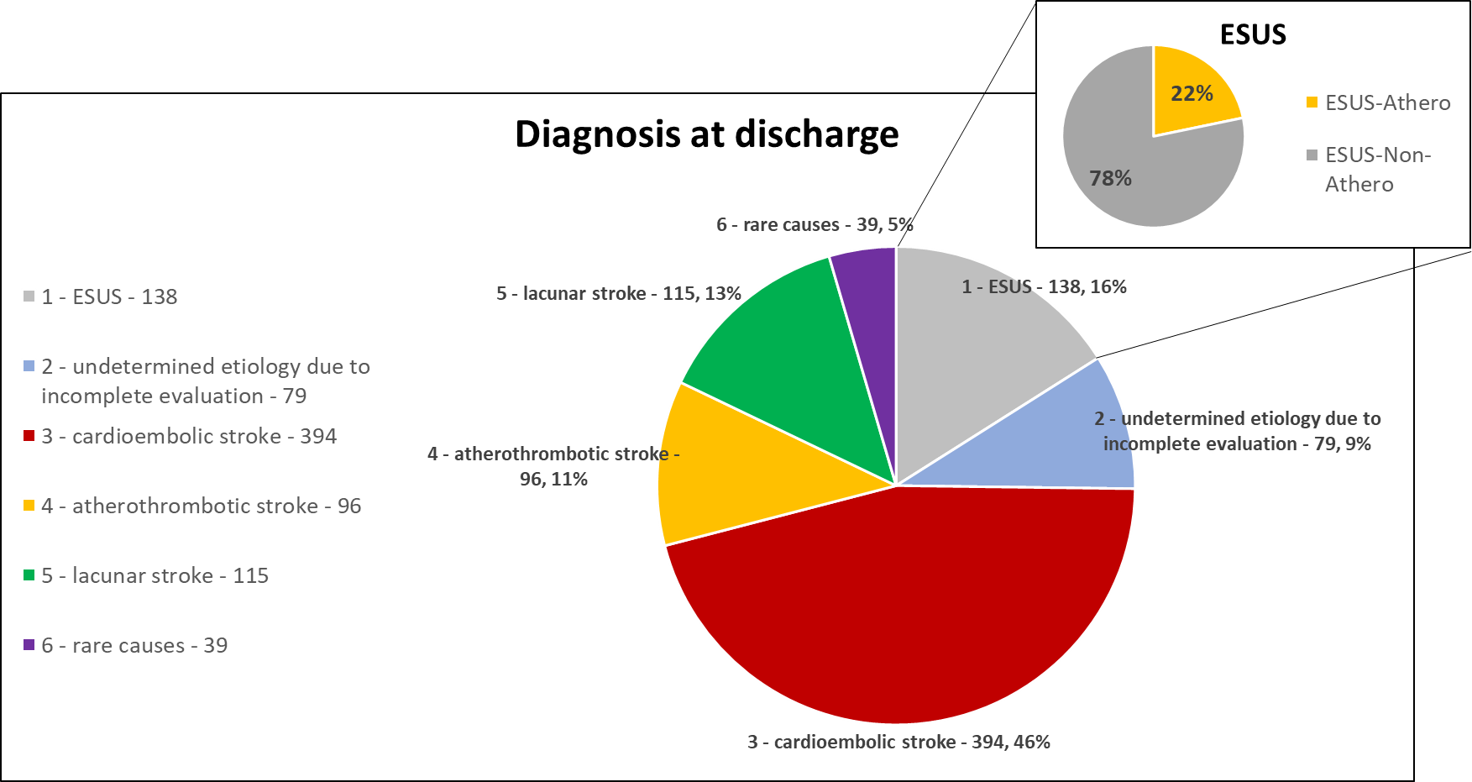
Results
Notes:
Statistical analysis:
A descriptive analysis was performed to describe the two populations.
A chi-square test of independence was performed to examine whether there is a difference between clinical variables at time of diagnosis and clinical outcomes after 5 years between the two groups.
A Mann-Whitney U test was employed to assess whether a difference exists between cholesterol levels between the two groups.

Slide 6
 |  |  | Athero (N=30) | NonAthero (N=108) | Chi-Square p
Risk factos at time of stroke | HTN | Yes | 23 (79.3%) | 75 (70.1%) | 0.327
 |  | No | 6 (20.7%) | 32 (29.9%)
 | Type 2 Diabetes Mellitus | Yes | 8 (27.6%) | 26 (24.3%) | 0.717
 |  | No | 21 (72.4%) | 81 (75.7%)
 | Dyslipidemia | Yes | 15 (51.7%) | 58 (54.7%) | 0.774
 |  | No | 14 (48.3%) | 48 (45.3%)
 | Tobacco Smoking | Yes | 6 (20.7%) | 4 (3.7%) | 0.007*
 |  | No | 23 (79.3%) | 103 (96.3%)
 | Alcoholism | Yes | 3 (10.3%) | 10 (9.3%) | 1.000*
 |  | No | 26 (89.7%) | 97 (90.7%)
 | Heart Failure | Yes | 1 (3.4%) | 16 (15%) | 0.121*
 |  | No | 28 (96.6%) | 91 (85%)
Follow-up at 5 years | Recurrence of cerebrovascular event | Yes | 7 (23.3%) | 15 (14.9%) | 0.275
 |  | No | 23 (76.7%) | 86 (85.1%)
 | Non-vascular death | Yes | 5 (17.2%) | 18 (18.4%) | 0.890
 |  | No | 24 (82.8%) | 80 (81.6%)
 | Vascular death | Yes | 1 (3.4%) | 4 (4.1%) | 1.000*
 |  | No | 28 (96.6%) | 94 (95.9%)
 | Myocardial infarction | Yes | 2 (6.9%) | 1 (1%) | 0.130*
 |  | No | 27 (93.1%) | 97 (99%)
 | Hemorrhagic stroke | Yes | 1 (3.4%) | 4 (4.1%) | 1.000*
 |  | No | 28 (96.6%) | 94 (95.9%)
 | Major hemorrhage | Yes | 0 (0%) | 1 (1%) | 1.000*
 |  | No | 29 (100%) | 97 (99%)
 | Atrial fibrillation | Yes | 1 (3.3%) | 18 (18.4%) | 0.044*
 |  | No | 29 (96.7%) | 80 (85.2%)
Results
ESUS-NonAthero group had more frequently AF diagnosis at 5-year follow-up (18.4% vs. 3.3%, p=0.044)
*Fisher’s Exact Test
Notes:
O grupo de doentes com “ESUS-NãoAtero” teve mais frequentemente o diagnóstico de FA aos 5 anos (18.4% vs. 3.3%, p=0.044)
Statistical analysis:
A descriptive analysis was performed to describe the two populations.
A chi-square test of independence was performed to examine whether there is a difference between clinical variables at time of diagnosis and clinical outcomes after 5 years between the two groups.
A Mann-Whitney U test was employed to assess whether a difference exists between cholesterol levels between the two groups.

Slide 7
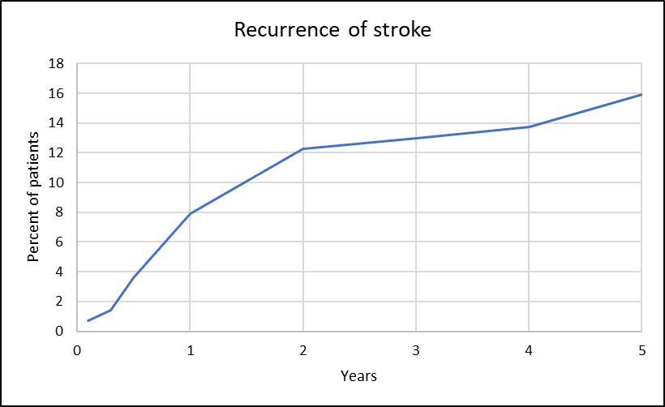
Results
99,27% of patients with ESUS were discharged with long-term antiplatelet therapy.
15.9% of ESUS had another vascular event at 5 years (3.18%/year), with most events occurring in the first 2 years (77.3%).
We found no significant differences in recurrence of vascular events or in death at 5 years between “ESUS-Athero” and “ESUS-NonAthero” groups.
Notes:
- 99,27% of patients with ESUS were discharged with long-term antiplatelet therapy.
- 15.9% of ESUS had another vascular event at 5 years (3.18%/year), with most events occurring in the first 2 years (77.3%)
- We found no significant differences in recurrence of vascular events or in death at 5 years between “ESUS-Athero” and “ESUS-NonAthero” groups.

Slide 8
Conclusions
There is a significant difference in AF detection at 5-year follow-up between “ESUS-Athero” and “ESUS-NonAthero” groups – AF less frequent in “ESUS-Athero” group.
No significant differences in mortality recurrent events between “ESUS-Athero” and “ESUS-NonAthero” groups.
Different sub-groups within the ESUS definition exits.
More studies are needed to better classify these sub-groups for then to define better preventive strategies to reduce stroke recurrence.
Limitations: unicentric, retrospective study, reduced number of patients and no control group.

